Slide 1
Neural Networks

Slide 2
Summary of this lesson
“Tell me and I forget. Teach me and I remember. Involve me and I learn.”
-Benjamin Franklin
How do machines learn?
*This lesson refers to chapter 9 of the GIDS book

Slide 3
Content of this lesson
Multilayer Perceptrons
  The Perceptron
  Why the Perceptron is not enough
  The MLP
The Back Propagation algorithm
  The delta rule to train the output neurons
  Recursivity to train the hidden neurons
  Learning rate and local minima
MLP and BackPropagation
  Pro‘s and Con‘s
    Black-box tools
    Overfitting
    Techniques to avoid overfitting
    Special architectures

Slide 4
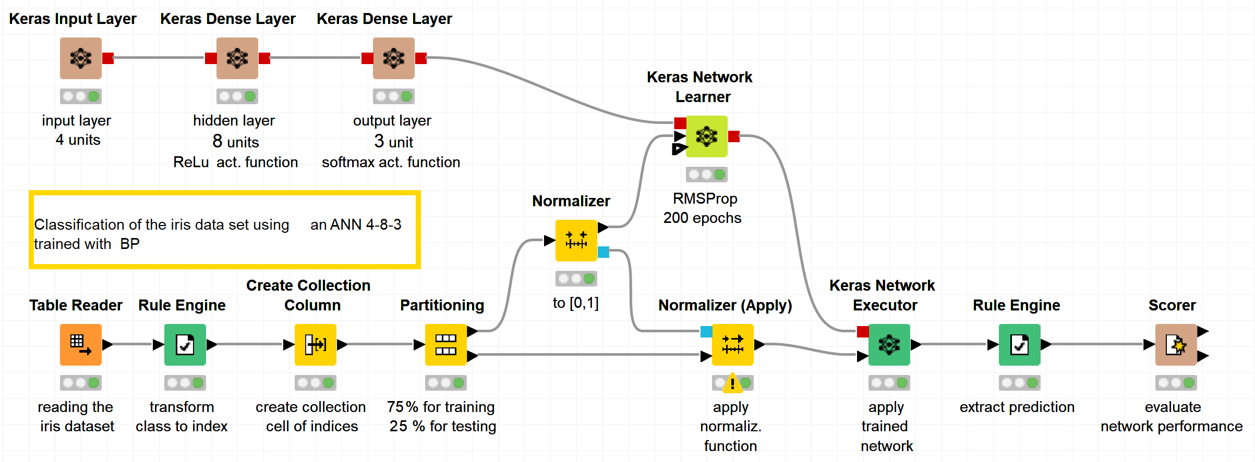
Datasets
Datasets used : iris dataset
Example Workflows:
  „Classifying the iris data set with ANN“ https://kni.me/w/ei3eX9Sj5-RFEUat
    Keras layers
    Multi-layer perceptrion
    Back propagation

Slide 5
Classification vs. Regression
Supervised Learning
A target attribute is predicted based on other attributes
Assumption: in addition to the object description x, we have also the value for the target attribute y
Transparent
The decision process maps the application domain
How did we come to this final medical diagnosis?
Black-box
Abstract mathematical procedures not meaningful for the application domain
Recover most similar face in a million. How and why is not important.

Slide 6
Biological Neuron

Slide 7
Artificial Neural Networks
Artificial Neural Networks (ANN) are among the oldest and most intensely studied Machine Learning approaches
They took their inspiration from biological neural networks and tried to mimic the learning process of animals and humans
However, the model of biological processes ended up to be very coarse, and several improvements to the basic approach have even abandoned the biological analogy
Advantage
Highly flexible ➔ good performance
Disadvantage
Black-box models not easy to interpret

Slide 8
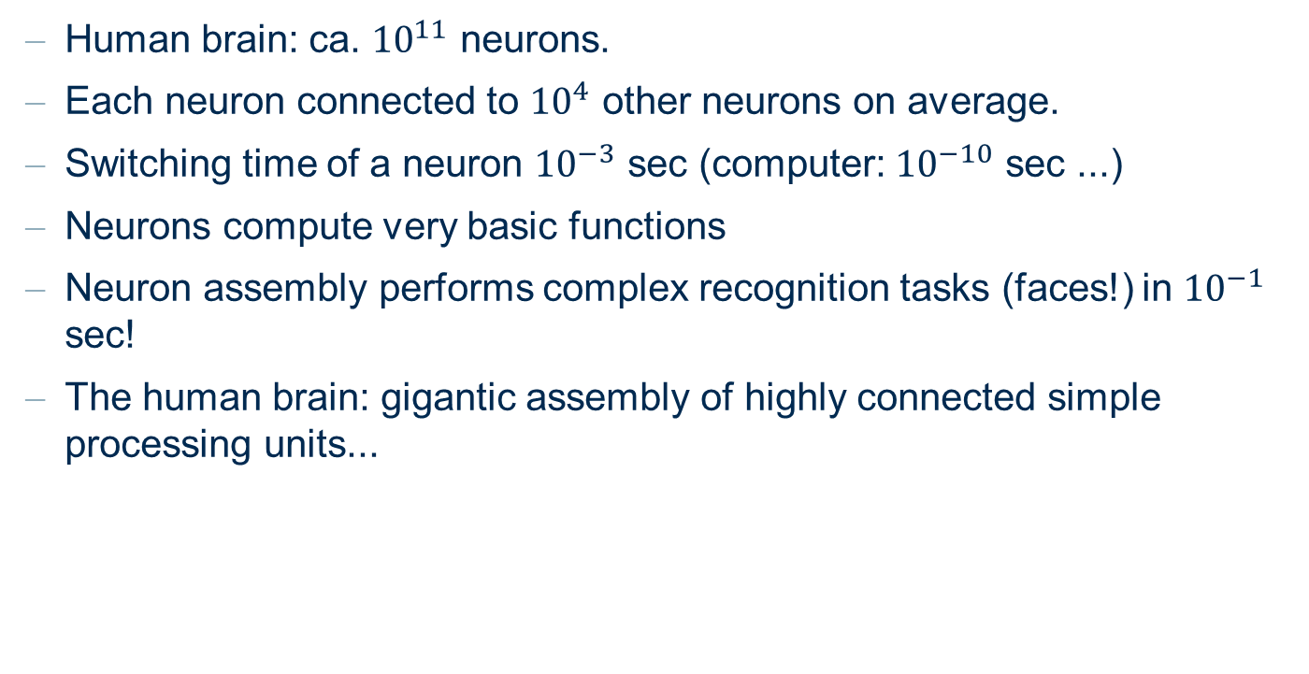
Biological Neural Networks
Human brain: ca. ${10}^{11}$ neurons.
Each neuron connected to ${10}^{4}$ other neurons on average.
Switching time of a neuron ${10}^{−3}$ sec (computer: ${10}^{−10}$ sec ...)
Neurons compute very basic functions
Neuron assembly performs complex recognition tasks (faces!) in ${10}^{−1}$ sec!
The human brain: gigantic assembly of highly connected simple processing units...

Slide 9
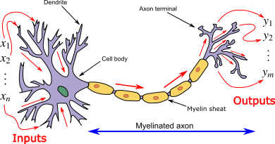
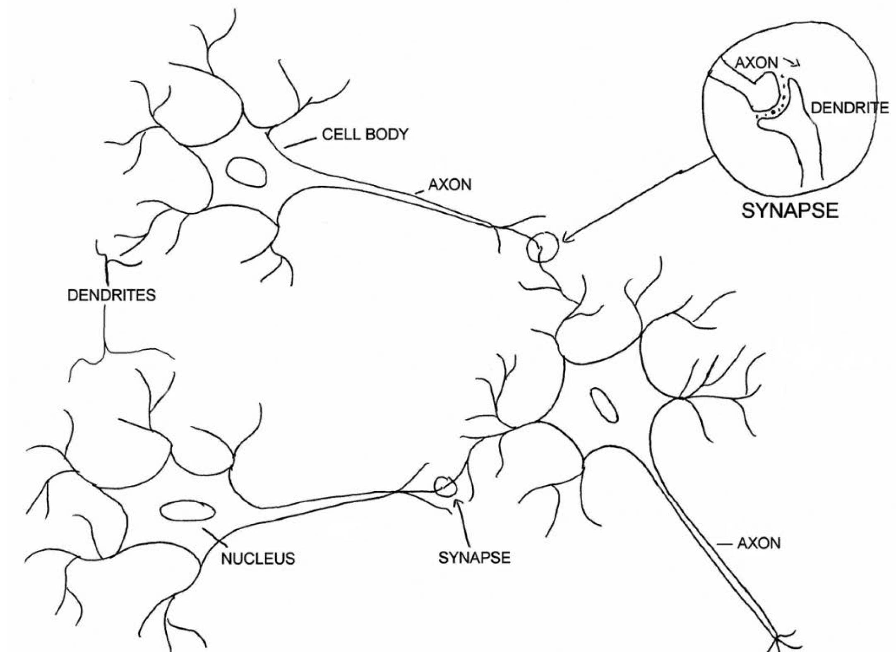
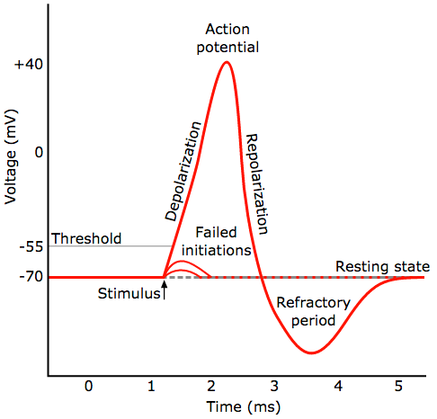
Biological Neuron
Biological Neuron
Biological Neural Networks
Guide to Intelligent Data Science Second Edition, 2020

Slide 10
Perceptron

Slide 11
McCulloch-Pitts Model of a neuron (1943)
Aim: neurobiological modelling and simulation to understand very elementary functions of neurons and brain.
A neuron is a binary switch, being either active or inactive.
Each neuron has a fixed threshold value.
A neuron receives input signals from excitatory (positive) synapses
(connections to other neuron).
A neuron receives input signals from inhibitory (negative) synapses (connections to other neuron).
Inputs to a neuron are accumulated (integrated) for a certain time. When the threshold value of the neuron is exceeded, the neuron becomes active and sends signals to its neighbouring neurons via its synapses.

Slide 12
The Perceptron (Rosenblatt, 1958)
The perceptron was introduced by Frank Rosenblatt for modelling pattern recognition abilities in 1958.
Aim: Automatic learning of weights and threshold of a model of a retina to correctly classify objects.
A simplified retina is equipped with receptors (input neurons) that are activated by an optical stimulus.
The stimulus is passed on to an output neuron via a weighted connection (synapse).
When the threshold of the output neuron is exceeded, the output is 1, otherwise 0.

Slide 13
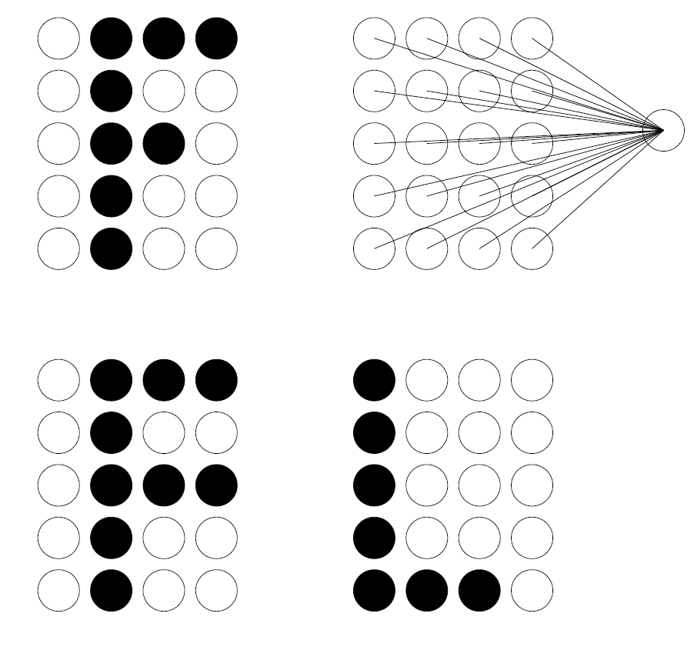
Identifying the letter F
2 positive and 1 negative example

Slide 14






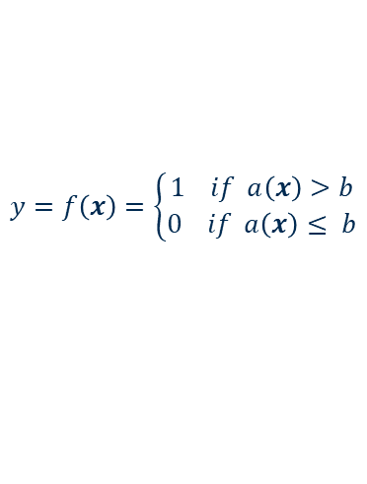



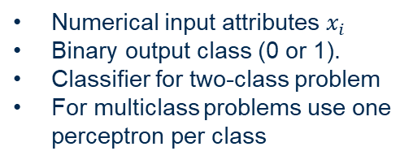
Biological Neuron vs. Perceptron
Biological Neuron
Biological Neural Networks
Artificial Neuron (Perceptron)
$$b$$
$$x_{1}$$
$$a(x)=\sum_{i=1}^{n}{x_{i}w_{i}}$$
$$x_{i}$$
$$w_{1}$$
Numerical input attributes $x_{i}$
Binary output class (0 or 1).
Classifier for two-class problem
For multiclass problems use one perceptron per class
$$w_{i}$$
f( )
y
$$∑$$
$$σ$$
$$x_{n}$$
$$w_{n}$$
$$y=f\left(x\right)=\left\{\begin{aligned}1 if a\left(x\right)>b \\ 0 if a\left(x\right)≤ b\end{aligned}\right.$$
Guide to Intelligent Data Science Second Edition, 2020

Slide 15
Perceptron Learning Algorithm
Initialise the weight and the threshold values randomly.
For each data object in the training data set, check whether the perceptron predicts the correct class.
If the perceptron predicts the wrong class, adjust the weights and threshold value to improve the prediction.
Repeat this until no changes occur

Slide 16
The delta rule
Whenever the perceptron makes a wrong classification
➔ change weights and threshold in ”appropriate direction”.
If the desired output is 1 and the perceptron’s output is 0, the threshold is not exceeded, although it should be. Therefore, lower the threshold and adjust the weights depending on the sign and magnitude of the inputs.
If the desired output is 0 and the perceptron’s output is 1, the threshold is exceeded, although it should not be. Therefore, increase the threshold and adjust the weights depending on the sign and magnitude of the inputs.

Slide 17
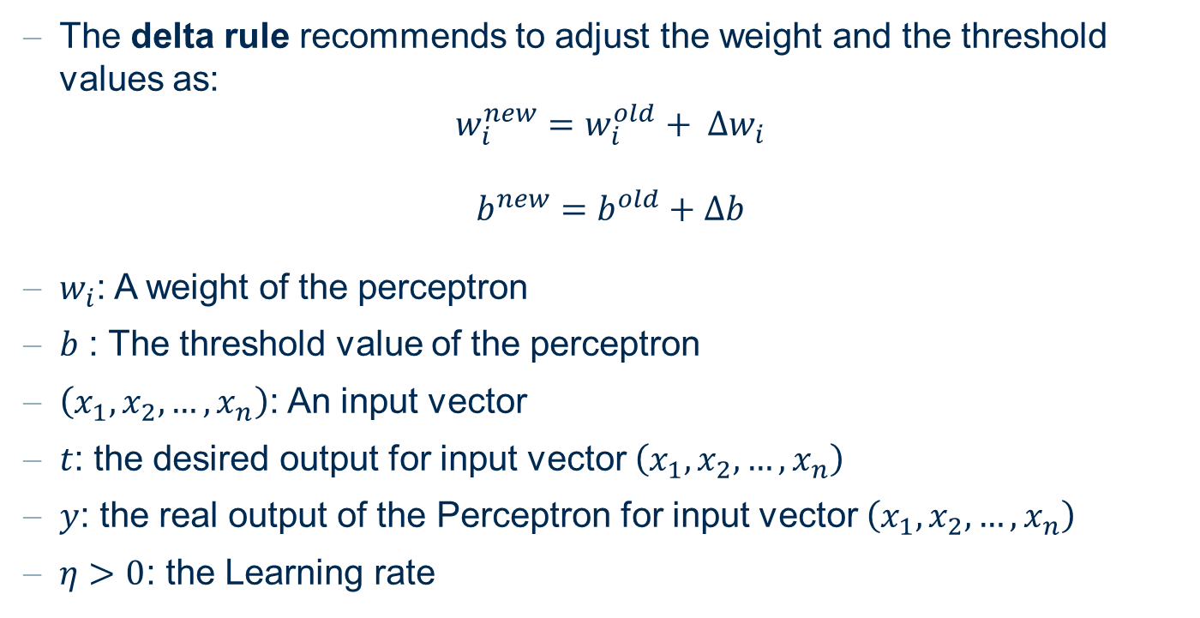
The delta rule
The delta rule recommends to adjust the weight and the threshold values as:
$${w_{i}^{new}=w_{i}^{old}+ ∆w}_{i}$$
$$b^{new}=b^{old}+∆b$$
$w_{i}$: A weight of the perceptron
$b$ : The threshold value of the perceptron
$\left(x_{1}, x_{2}, …, x_{n}\right)$: An input vector
$t$: the desired output for input vector $\left(x_{1}, x_{2}, …, x_{n}\right)$
$y$: the real output of the Perceptron for input vector $\left(x_{1}, x_{2}, …, x_{n}\right)$
$η>0$: the Learning rate

Slide 18
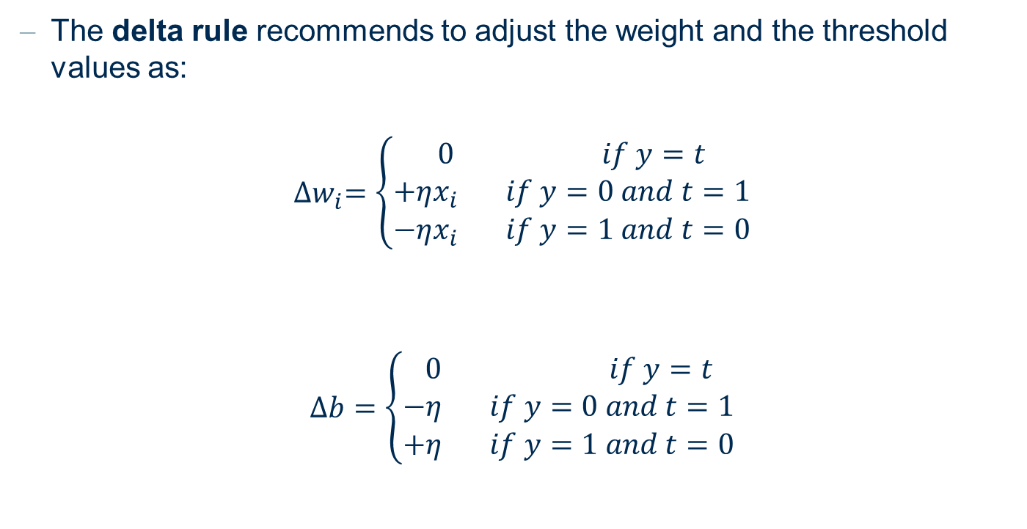
The delta rule
The delta rule recommends to adjust the weight and the threshold values as:
$${∆w}_{i}=\left\{\begin{aligned}0 if y=t \\ +ηx_{i} if y=0 and t=1 \\ −ηx_{i} if y=1 and t=0\end{aligned}\right.$$
$$∆b=\left\{\begin{aligned}0 if y=t \\ −η if y=0 and t=1 \\ +η if y=1 and t=0\end{aligned}\right.$$

Slide 19








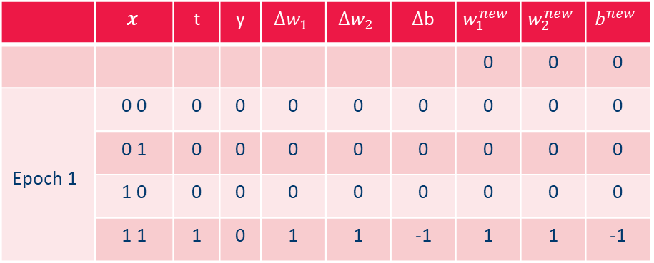

Example: Learning the logical operator AND
Inputs
Training Data:
  {((0,0),0), ((0,1),0), ((1,0),0), ((1,1), 1)}
Learning rate $η=1$
Initialization: $w_{1}=w_{2}=b=0$
$$x_{2}$$
0
1
target
0
0
$$x_{1}$$
 | $$x$$ | t | y | $${∆w}_{1}$$ | $${∆w}_{2}$$ | $∆$b | $$w_{1}^{new}$$ | $$w_{2}^{new}$$ | $$b^{new}$$
 |  |  |  |  |  |  | 0 | 0 | 0
Epoch 1 | 0 0 | 0 | 0 | 0 | 0 | 0 | 0 | 0 | 0
 | 0 1 | 0 | 0 | 0 | 0 | 0 | 0 | 0 | 0
 | 1 0 | 0 | 0 | 0 | 0 | 0 | 0 | 0 | 0
 | 1 1 | 1 | 0 | 1 | 1 | -1 | 1 | 1 | -1
$$x_{1}$$
$$b$$
$$w_{1}$$
f( )
y
$$∑$$
$$σ$$
$$x_{2}$$
$$w_{2}$$

Slide 20
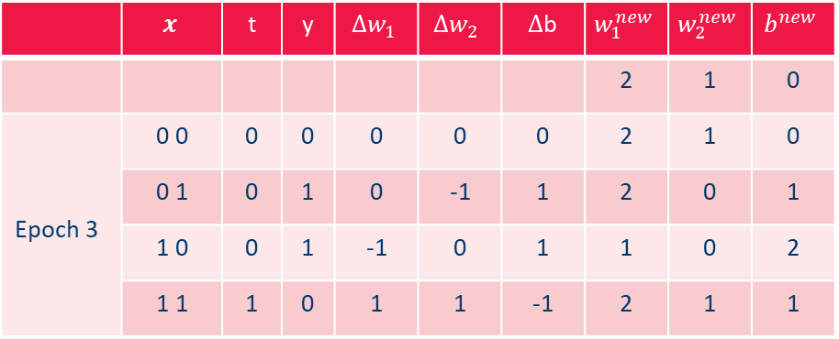
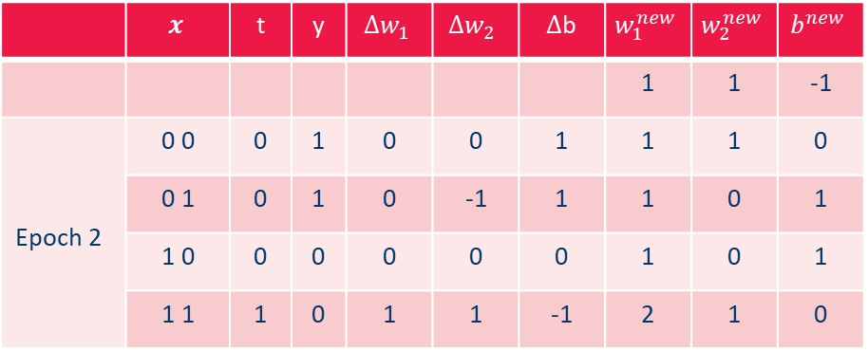
Example: Learning the logical operator AND
 | $$x$$ | t | y | $${∆w}_{1}$$ | $${∆w}_{2}$$ | $∆$b | $$w_{1}^{new}$$ | $$w_{2}^{new}$$ | $$b^{new}$$
 |  |  |  |  |  |  | 1 | 1 | -1
Epoch 2 | 0 0 | 0 | 1 | 0 | 0 | 1 | 1 | 1 | 0
 | 0 1 | 0 | 1 | 0 | -1 | 1 | 1 | 0 | 1
 | 1 0 | 0 | 0 | 0 | 0 | 0 | 1 | 0 | 1
 | 1 1 | 1 | 0 | 1 | 1 | -1 | 2 | 1 | 0
 | $$x$$ | t | y | $${∆w}_{1}$$ | $${∆w}_{2}$$ | $∆$b | $$w_{1}^{new}$$ | $$w_{2}^{new}$$ | $$b^{new}$$
 |  |  |  |  |  |  | 2 | 1 | 0
Epoch 3 | 0 0 | 0 | 0 | 0 | 0 | 0 | 2 | 1 | 0
 | 0 1 | 0 | 1 | 0 | -1 | 1 | 2 | 0 | 1
 | 1 0 | 0 | 1 | -1 | 0 | 1 | 1 | 0 | 2
 | 1 1 | 1 | 0 | 1 | 1 | -1 | 2 | 1 | 1

Slide 21

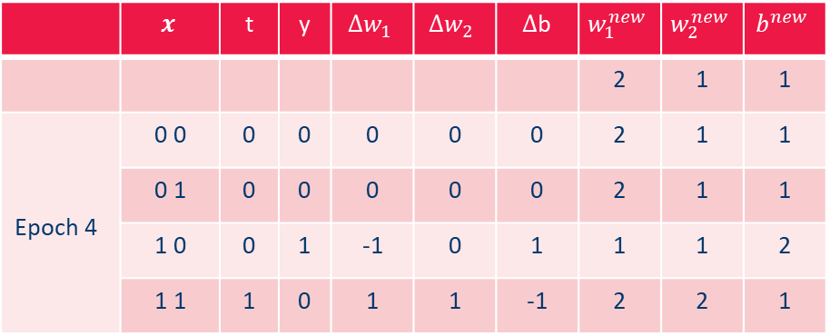
Example: Learning the logical operator AND
 | $$x$$ | t | y | $${∆w}_{1}$$ | $${∆w}_{2}$$ | $∆$b | $$w_{1}^{new}$$ | $$w_{2}^{new}$$ | $$b^{new}$$
 |  |  |  |  |  |  | 2 | 1 | 1
Epoch 4 | 0 0 | 0 | 0 | 0 | 0 | 0 | 2 | 1 | 1
 | 0 1 | 0 | 0 | 0 | 0 | 0 | 2 | 1 | 1
 | 1 0 | 0 | 1 | -1 | 0 | 1 | 1 | 1 | 2
 | 1 1 | 1 | 0 | 1 | 1 | -1 | 2 | 2 | 1
 | $$x$$ | t | y | $${∆w}_{1}$$ | $${∆w}_{2}$$ | $∆$b | $$w_{1}^{new}$$ | $$w_{2}^{new}$$ | $$b^{new}$$
 |  |  |  |  |  |  | 2 | 2 | 1
Epoch 5 | 0 0 | 0 | 0 | 0 | 0 | 0 | 2 | 2 | 1
 | 0 1 | 0 | 1 | 0 | -1 | 1 | 2 | 1 | 2
 | 1 0 | 0 | 0 | 0 | 0 | 0 | 2 | 1 | 2
 | 1 1 | 1 | 1 | 0 | 0 | 0 | 2 | 1 | 2

Slide 22
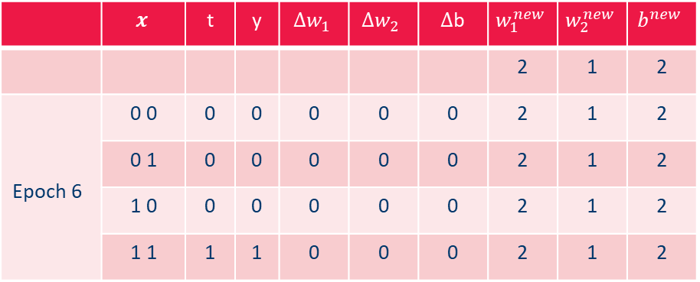
Example: Learning the logical operator AND
 | $$x$$ | t | y | $${∆w}_{1}$$ | $${∆w}_{2}$$ | $∆$b | $$w_{1}^{new}$$ | $$w_{2}^{new}$$ | $$b^{new}$$
 |  |  |  |  |  |  | 2 | 1 | 2
Epoch 6 | 0 0 | 0 | 0 | 0 | 0 | 0 | 2 | 1 | 2
 | 0 1 | 0 | 0 | 0 | 0 | 0 | 2 | 1 | 2
 | 1 0 | 0 | 0 | 0 | 0 | 0 | 2 | 1 | 2
 | 1 1 | 1 | 1 | 0 | 0 | 0 | 2 | 1 | 2
Perceptron Convergence
If, for a given data set with two classes, there exists a perceptron that can classify all patterns correctly, then the delta rule will adjust the weights and the threshold after a finite number of steps in such way that all patterns are classified correctly.
What classification problems can a perceptron solve?

Slide 23
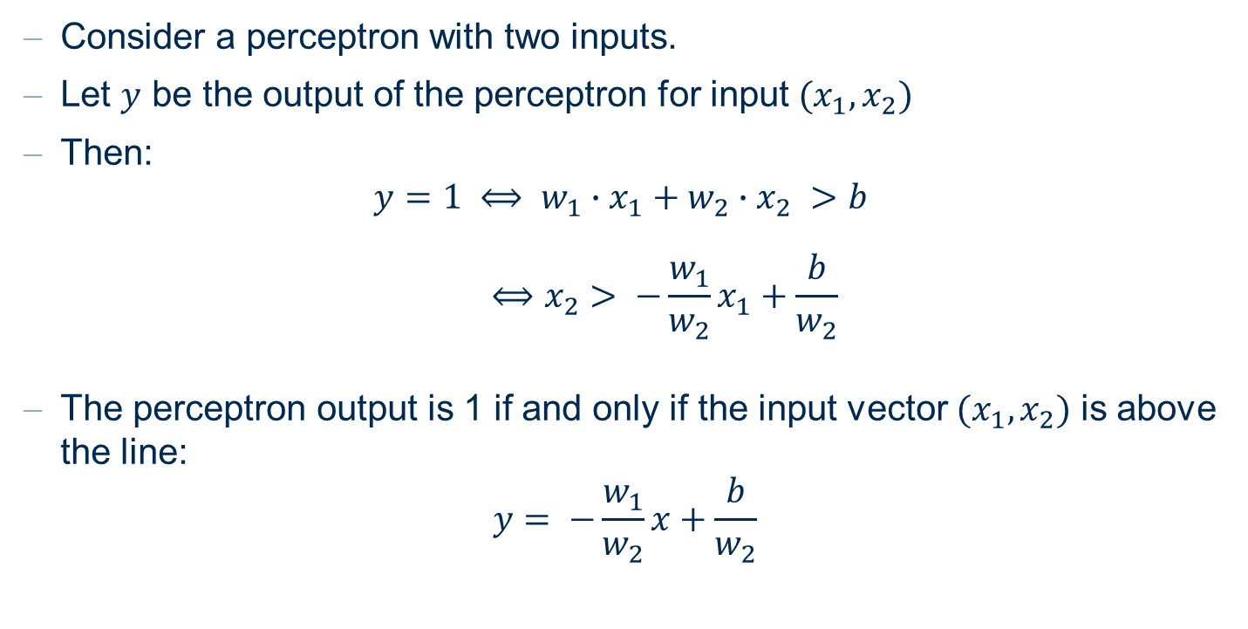
Linear separability
Consider a perceptron with two inputs.
Let $y$ be the output of the perceptron for input ${(x}_{1},x_{2})$
Then:
$$y=1 ⟺ w_{1}∙x_{1}+w_{2}∙x_{2} >b$$
$$⟺x_{2}> −\frac{w_{1}}{w_{2}}x_{1}+\frac{b}{w_{2}}$$
The perceptron output is 1 if and only if the input vector ${(x}_{1},x_{2})$ is above the line:
$$y= −\frac{w_{1}}{w_{2}}x+\frac{b}{w_{2}}$$

Slide 24

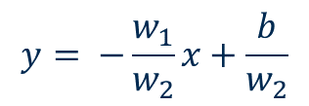


Linear Separability
$$x_{2}$$
$$y= −\frac{w_{1}}{w_{2}}x+\frac{b}{w_{2}}$$
class 1
class 0
$$x_{1}$$
The parameters $w_{1}$, $w_{2}$, define the line. All input patterns above this line are assigned to class 1, all input patterns below the line to class 0.

Slide 25

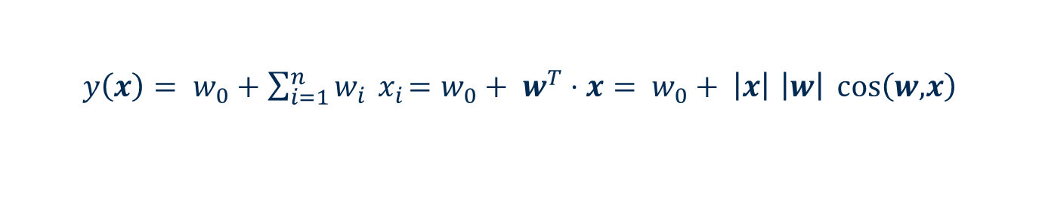


Linear Separability in hyperspaces
$y\left(x\right)= w_{0}+\sum_{i=1}^{n}{w_{i}{ x}_{i}=w_{0}+ w^{T}⋅x= }$ $w_{0}+ \left|x\right|$ $\left|w\right| \cos\left(w\text{,}x\right)$
$$w$$
$$\cos\left(w\text{,}x\right)>0$$
$$\cos\left(w\text{,}x\right)<0$$
Perceptrons implements hyperplanes in the feature space

Slide 26
Linear Separability
A Perceptron with n input neurons can classify all examples from a dataset with n input variables and two classes correctly, if there exists a hyperplane separating the two classes
Such classification problems are called linearly separable
A Perceptron can only solve linearly separable problems

Slide 27
What can a single Perceptron do?
Example: The exclusive OR (XOR) defines a classification task which is not linearly separable.
1
1
0
1
OR
AND
0
1
0
0
1
0
?
XOR
0
1
Guide to Intelligent Data Science Second Edition, 2020

Slide 28








Adding one more layer
The exclusive OR (XOR) can be solved adding one more layer
$$x_{2}$$
1
0
XOR
0
1
$$o_{1}$$
$$o_{2}$$
$$x_{1}$$
$$o_{2}$$
1
x
y
$$x_{1}$$
$$x_{2}$$
0
0
1
$$o_{1}$$
Guide to Intelligent Data Science Second Edition, 2020

Slide 29
FeedForward Neural Networks

Slide 30
Multi-Layer Perceptron (MLP)
A Perceptron with more than one layer is a Multi-Layer Perceptron (MLP)
A MLP is a neural network with:
  an input layer,
  one or more hidden layers, and
  an output layer
Connections exist only between neurons from one layer to the next layer

Slide 31







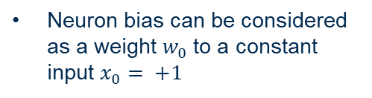


Bias as weight for a constant input
Biological Neuron
Biological Neural Networks
Artificial Neuron (Perceptron)
$$y={f(x}_{1}w_{1}+x_{2}w_{2}+b)$$
$$x_{0}=+1$$
$$x_{1}$$
$$b=w_{0}$$
$$b=w_{0}$$
$$b$$
Neuron bias can be considered as a weight $w_{0}$to a constant input $x_{0}= +1$
$$w_{1}$$
$$a(x)=\sum_{i=0}^{n}{x_{i}w_{i}}$$
f( )
y
$$∑$$
$$σ$$
$$x_{2}$$
$$w_{2}$$
$$y(x)=f(\sum_{i=0}^{n}{x_{i}w_{i}})$$
Guide to Intelligent Data Science Second Edition, 2020

Slide 32





MLP: Example
$$x_{2}$$
y
2
b
?
1
b
$$1$$
$$x_{1}$$
$$x_{2}$$
$$x_{1}$$
1
2
Guide to Intelligent Data Science Second Edition, 2020
Notes:
Beispiel:
2 Eingaben, eine Ausgabe. Stufenfunktion in den Neuronen. 1er-Neuron fuer Schwellwert der Stufenfunktion:
Wie sieht die Ausgabe des MLP abhängig von den zwei Eingaben x und y aus?

Slide 33


MLP: Example
$$x_{2}$$
$$1+\frac{1}{2}x−y<0$$
=0
y
2
=1
$$1+\frac{1}{2}x−y>0$$
1
$$1$$
$$x_{1}$$
$$x_{2}$$
$$x_{1}$$
1
2
Guide to Intelligent Data Science Second Edition, 2020
Notes:
Beispiel:
2 Eingaben, eine Ausgabe. Stufenfunktion in den Neuronen. 1er-Neuron fuer Schwellwert der Stufenfunktion:
Wie sieht die Ausgabe des MLP abhängig von den zwei Eingaben x und y aus?

Slide 34


MLP: Example
$$x_{2}$$
$$1+\frac{1}{2}x−y<0$$
=0
y
2
=1
$$1+\frac{1}{2}x−y>0$$
1
$$2−x−y<0$$
=1
=0
$$2−x−y>0$$
$$1$$
$$x_{1}$$
$$x_{2}$$
$$x_{1}$$
1
2
Guide to Intelligent Data Science Second Edition, 2020
Notes:
Beispiel:
2 Eingaben, eine Ausgabe. Stufenfunktion in den Neuronen. 1er-Neuron fuer Schwellwert der Stufenfunktion:
Wie sieht die Ausgabe des MLP abhängig von den zwei Eingaben x und y aus?

Slide 35
MLP: Example
$$x_{2}$$
=0
y
2
=1
1
=1
=0
$$1$$
$$x_{1}$$
$$x_{2}$$
$$x_{1}$$
1
2
Guide to Intelligent Data Science Second Edition, 2020
Notes:
Beispiel:
2 Eingaben, eine Ausgabe. Stufenfunktion in den Neuronen. 1er-Neuron fuer Schwellwert der Stufenfunktion:
Wie sieht die Ausgabe des MLP abhängig von den zwei Eingaben x und y aus?

Slide 36

MLP: Example
$$x_{2}$$
=0
y
2
=1
-
$$−\frac{1}{2}$$
>0
1
=1
=0
$$1$$
$$x_{1}$$
$$x_{2}$$
$$x_{1}$$
1
2
Guide to Intelligent Data Science Second Edition, 2020
Notes:
Beispiel:
2 Eingaben, eine Ausgabe. Stufenfunktion in den Neuronen. 1er-Neuron fuer Schwellwert der Stufenfunktion:
Wie sieht die Ausgabe des MLP abhängig von den zwei Eingaben x und y aus?

Slide 37
MLP: Example
$$x_{2}$$
$$1+\frac{1}{2}x−y<0$$
=0
y
2
=1
$$1+\frac{1}{2}x−y>0$$
-
$$−\frac{1}{2}$$
>0
1
=1
=0
$$2−x−y>0$$
$$2−x−y<0$$
$$1$$
$$x_{1}$$
$$x_{2}$$
$$x_{1}$$
1
2
Guide to Intelligent Data Science Second Edition, 2020
Notes:
Beispiel:
2 Eingaben, eine Ausgabe. Stufenfunktion in den Neuronen. 1er-Neuron fuer Schwellwert der Stufenfunktion:
Wie sieht die Ausgabe des MLP abhängig von den zwei Eingaben x und y aus?

Slide 38













Biological vs. Perceptron
Biological Neuron
Biological Neural Networks
Artificial Neuron (Perceptron)
Artificial Neural Networks
(Multilayer Perceptron, MLP)
$$y={f(x}_{1}w_{1}+x_{2}w_{2}+b)$$
$$x_{0}=+1$$
$$x_{1}$$
$$x_{1}$$
$$b=w_{0}$$
$$b=w_{0}$$
$$b$$
$$w_{1}$$
$$a(x)=\sum_{i=0}^{n}{x_{i}w_{i}}$$
$$x_{2}$$
y
f( )
y
$$∑$$
$$σ$$
$$w_{2}$$
$$x_{3}$$
$$x_{2}$$
$$y(x)=f(\sum_{i=0}^{n}{x_{i}w_{i}})$$
$$x_{4}$$
Guide to Intelligent Data Science Second Edition, 2020

Slide 39
MLP: Example of Architecture / Topology
Let‘s see an example of a MLP
3 layers:
  1 input layer with m=2 inputs
  1 hidden layer with h=3 hidden neurons
  1 output layer with n=2 output neurons
All feed-forward connections: from a neuron only to neurons in the next layer
Fully-connected: that is each neuron in one layer is connected to all neurons in the next layers
fully connected
feed forward
neural networks
Guide to Intelligent Data Science Second Edition, 2020

Slide 40




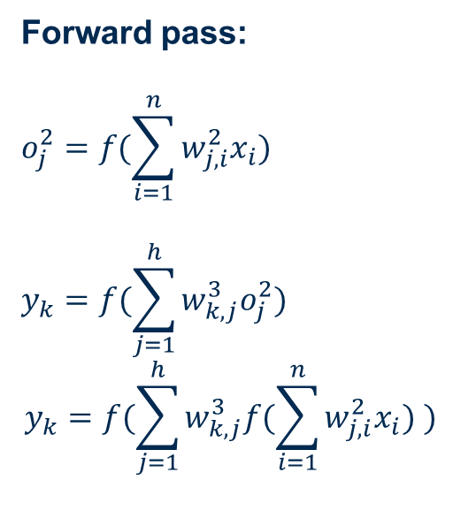






















Feed-Forward Neural Networks (FFNN)
Input
Layer #1
Hidden
Layer #2
Output
Layer #3
m=2 inputs
h=3 units
n=2 units
Forward pass:
$$o_{j}^{2}=f(\sum_{i=1}^{n}{w_{j,i}^{2}x_{i}})$$
$$y_{k}=f(\sum_{j=1}^{h}{w_{k,j}^{3}o_{j}^{2}})$$
$$y_{k}=f(\sum_{j=1}^{h}{w_{k,j}^{3}f(\sum_{i=1}^{n}{w_{j,i}^{2}x_{i}}) })$$
$$o_{1}^{2}$$
$$∑$$
$$f$$
$$w_{1,1}^{3}$$
$$w_{1,1}^{2}$$
#1
$$x_{1}$$
$$w_{1,2}^{2}$$
$$w_{2,1}^{3}$$
$$f$$
$$y_{1}$$
$$∑$$
$$o_{2}^{2}$$
$$w_{1,2}^{3}$$
$$w_{2,1}^{2}$$
$$f$$
#1
$$∑$$
$$w_{2,2}^{2}$$
$$w_{2,2}^{3}$$
$$x_{2}$$
#2
$$y_{2}$$
$$w_{3,1}^{2}$$
$$W_{1,3}^{3}$$
$$∑$$
$$f$$
$$o_{3}^{2}$$
$$w_{3,2}^{2}$$
$$w_{2,3}^{3}$$
#2
$$∑$$
$$f$$
To layer #3
To neuron #3 in next layer
From neuron #2 in previous layer
#3
Guide to Intelligent Data Science Second Edition, 2020
Notes:
- function which takes some input to calculate for example some probability for the output with some hidden layers in between
- In a feed forward network information travels from the input to the output without backwards connections
- When we apply a network we always take the values from the previous layer to calculate the activations in the next layer.
- In this small example we have fully connected network where each neuron from the previous layer is connected to the neurons in the next layer
- To calculate the activation of the hidden layer, we take the input values and multiply them with the according parameters called weights, sum them up and add in addition a bias values. This sum is then fed into an activation function which could be the sigmoid function.
- We can then use these activation values to calculate the probability for our output in the same way.
- The goal of training a network is to find the values for our parameters/ weights and this is normally done using back propagation

Slide 41




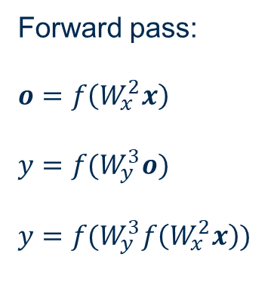






Same with Matrix Notations
Input
Layer #1
Hidden
Layer #2
Output
Layer #3
m=2 inputs
h=3 units
n=2 units
Forward pass:
$$o=f\left(W_{x}^{2}x\right)$$
$$y=f(W_{y}^{3}o)$$
$$y=f(W_{y}^{3}f\left(W_{x}^{2}x\right))$$
$$W_{x}^{2}$$
$$o_{1}^{2}$$
$$W_{y}^{3}$$
$$∑$$
$$f$$
$$x_{1}$$
$$∑$$
$$f$$
$$y_{1}$$
$$o_{2}^{2}$$
$$∑$$
$$f$$
$$x_{2}$$
$$∑$$
$$f$$
$$y_{2}$$
$f()$ = activation function
$$o_{3}^{2}$$
$$∑$$
$$f$$
Guide to Intelligent Data Science Second Edition, 2020

Slide 42
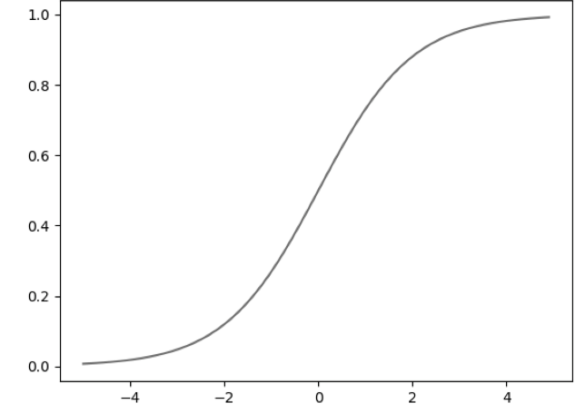
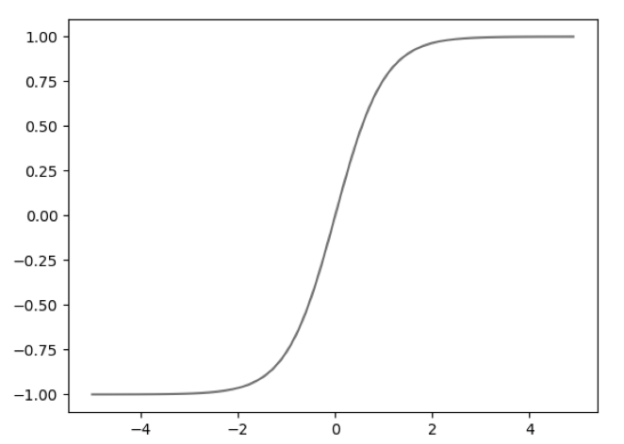
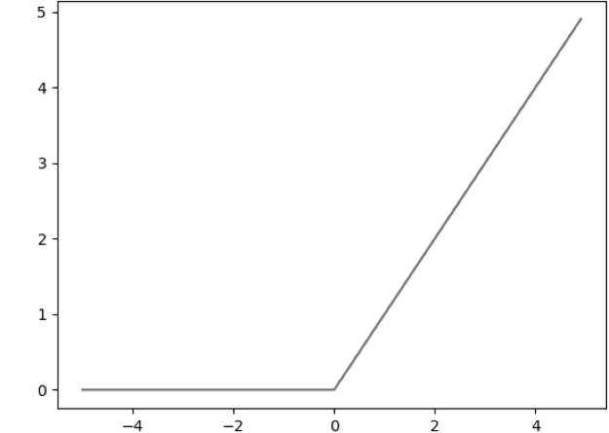



Frequently used activation functions
Sigmoid
Tanh
Rectified Linear Unit (ReLU)
$$f\left(a\right)= \frac{1}{1+e^{−ha}}$$
$$f\left(a\right)= \frac{e^{2ha}−1}{e^{2ha}+1}$$
$$f\left(a\right)=max\left\{0, ha\right\}$$
Guide to Intelligent Data Science Second Edition, 2020

Slide 43
Other Neural Architectures
completely
connected
feedforward
(directed, a-cyclic)
recurrent
(feedback connections)
example:
- associative
neural network
- Hopfield
example:
Multi Layer Perceptron
Auto-encoder MLP
example:
Recurrent Neural
Network (for time
series recognition)
Guide to Intelligent Data Science Second Edition, 2020

Slide 44
BackPropagation

Slide 45
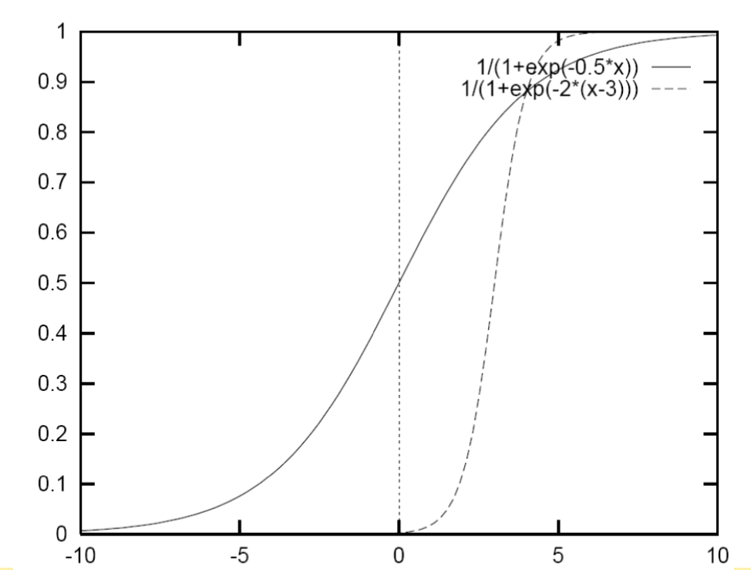
Learning Algorithm
Problem: How do we automatically adjust the weights (and thresholds) for the neurons of the hidden layer?
Solution: gradient descent
Does not work with binary (non-differentiable) threshold function as activation function for the neurons.
Activation function must be a differentiable function
Guide to Intelligent Data Science Second Edition, 2020

Slide 46
Training of a Feed Forward Neural Network - MLP
Teach (ensemble of) neuron(s) a desired input-output behavior.
Show examples from the training set repeatedly
Networks adjusts parameters to fit underlying function
  topology
  weights
  internal functional parameters
Guide to Intelligent Data Science Second Edition, 2020

Slide 47


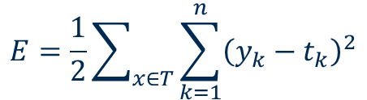

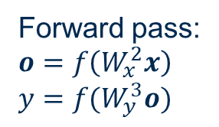




Error Function
Input
Layer #1
Hidden
Layer #2
Output
Layer #3
Number of output units
m=2 inputs
h=3 units
n=2 units
$$W_{x}^{2}$$
$$o_{1}^{2}$$
$$W_{y}^{3}$$
$$∑$$
$$f$$
$$E=\frac{1}{2}\sum_{x∈T}{\sum_{k=1}^{n}{{\left(y_{k}−t_{k}\right)}^{2}}}$$
$$x_{1}$$
$$∑$$
$$f$$
$$y_{1}$$
$$o_{2}^{2}$$
On the whole Training set
Network output value k
$$∑$$
$$f$$
Target
value k
$$x_{2}$$
$$∑$$
$$f$$
$$y_{2}$$
$$o_{3}^{2}$$
Forward pass:
$$o=f\left(W_{x}^{2}x\right)$$
$$y=f(W_{y}^{3}o)$$
$$∑$$
$$f$$
Guide to Intelligent Data Science Second Edition, 2020

Slide 48
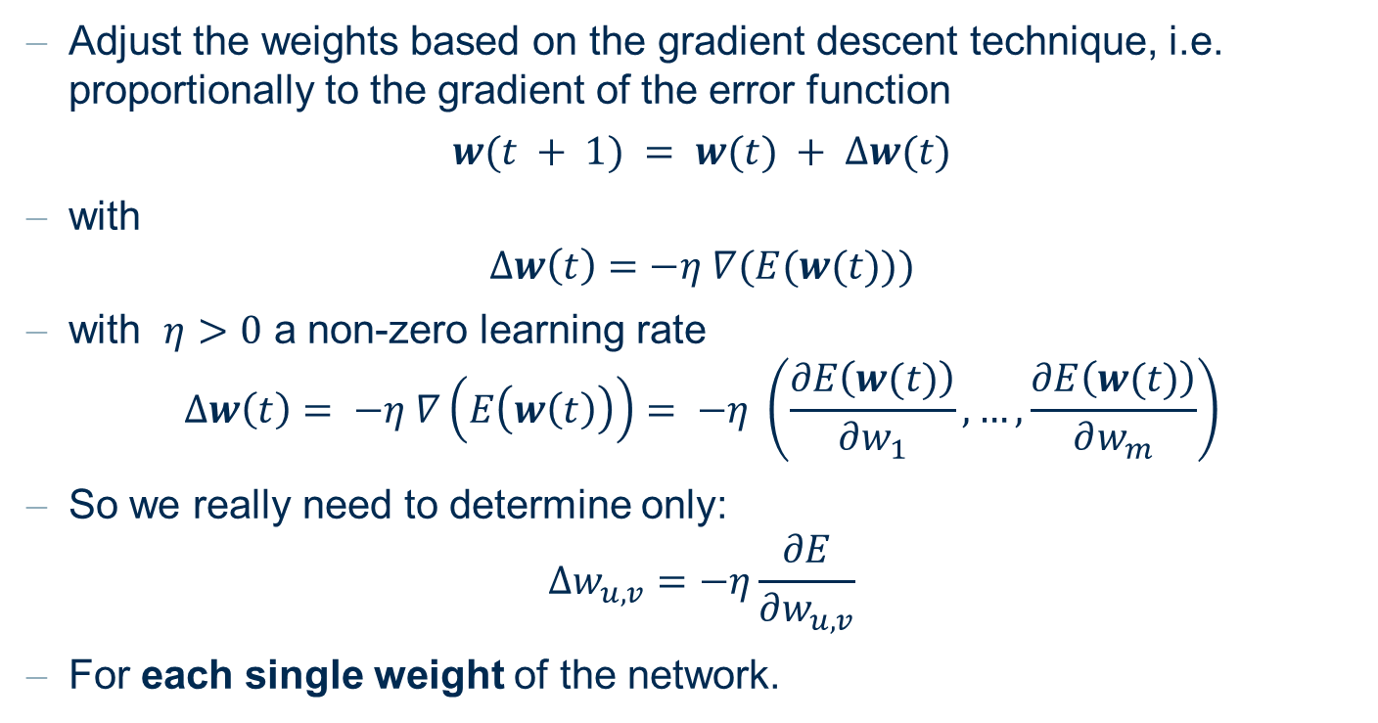
Learning Rule from Gradient Descent
Adjust the weights based on the gradient descent technique, i.e. proportionally to the gradient of the error function
$$w(t + 1) = w(t) + ∆w(t)$$
with
$$∆w\left(t\right)=−η ∇(E(w(t)))$$
with $η>0$ a non-zero learning rate
$$∆w\left(t\right)= −η ∇\left(E\left(w\left(t\right)\right)\right)= −η \left(\frac{∂E\left(w(t)\right)}{∂w_{1}}, …,\frac{∂E\left(w(t)\right)}{∂w_{m}}\right)$$
So we really need to determine only:
$$∆w_{u,v}=−η\frac{∂E}{∂w_{u,v}}$$
For each single weight of the network.
Guide to Intelligent Data Science Second Edition, 2020

Slide 49








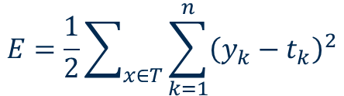











Learning Rule from Gradient Descent
Input
Layer #1
Hidden
Layer #2
Output
Layer #3
m=2 inputs
h=3 units
n=2 units
$$W_{x}^{2}$$
$$o_{1}^{2}$$
$$W_{y}^{3}$$
$$∑$$
$$f$$
$$E=\frac{1}{2}\sum_{x∈T}{\sum_{k=1}^{n}{{\left(y_{k}−t_{k}\right)}^{2}}}$$
$$x_{1}$$
$$∑$$
$$f$$
$$y_{1}$$
$$o_{2}^{2}$$
$$∑$$
$$f$$
Gradient descent
$$x_{2}$$
$$∑$$
$$f$$
$$y_{2}$$
$$o_{3}^{2}$$
$$∆w_{u,v}=−η\frac{∂E}{∂w_{u,v}}$$
$$∑$$
$$f$$
Guide to Intelligent Data Science Second Edition, 2020

Slide 50
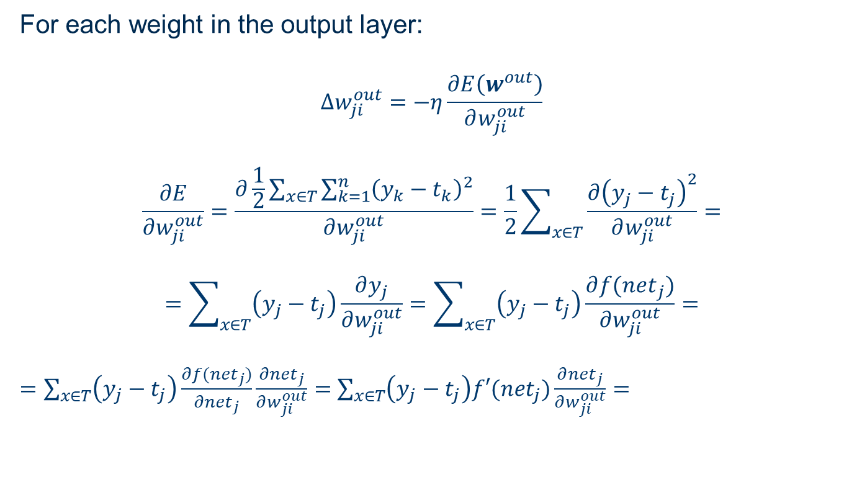
... Some Calculations for the Output Layer ....
For each weight in the output layer:
$$∆w_{ji}^{out}=−η\frac{∂E\left(w^{out}\right)}{∂w_{ji}^{out}}$$
$$\frac{∂E}{∂w_{ji}^{out}}=\frac{∂\frac{1}{2}\sum_{x∈T}{\sum_{k=1}^{n}{{\left(y_{k}−t_{k}\right)}^{2}}}}{∂w_{ji}^{out}}=\frac{1}{2}\sum_{x∈T}{\frac{∂{\left(y_{j}−t_{j}\right)}^{2}}{∂w_{ji}^{out}}=}$$
$$=\sum_{x∈T}{\left(y_{j}−t_{j}\right)\frac{∂y_{j}}{∂w_{ji}^{out}}=\sum_{x∈T}{\left(y_{j}−t_{j}\right)\frac{∂{f(net}_{j})}{∂w_{ji}^{out}}=}}$$
$=\sum_{x∈T}{\left(y_{j}−t_{j}\right)\frac{∂{f(net}_{j})}{∂{net}_{j}}\frac{{∂net}_{j}}{∂w_{ji}^{out}}=}$ $\sum_{x∈T}{\left(y_{j}−t_{j}\right)f′({net}_{j})\frac{∂{net}_{j}}{∂w_{ji}^{out}}=}$
To output neuron j
From hidden neuron i
Net input to output neuron j
Guide to Intelligent Data Science Second Edition, 2020

Slide 51

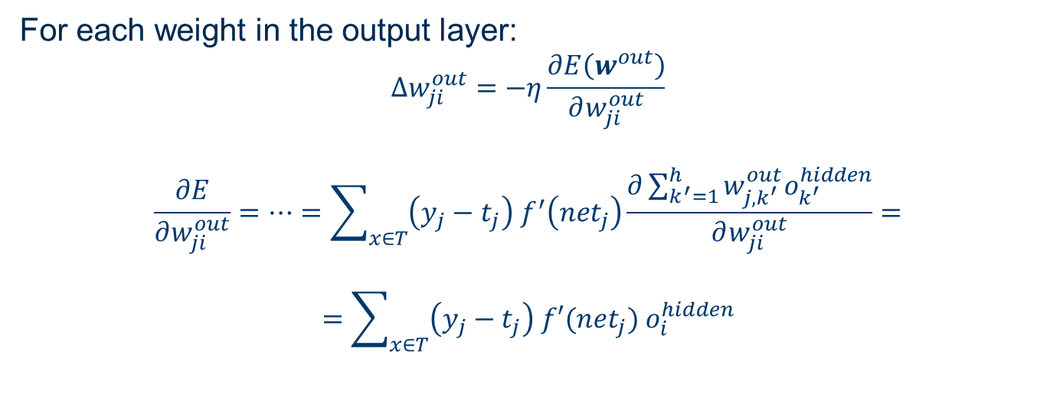
... Some Calculations for the Output Layer ....
For each weight in the output layer:
$$∆w_{ji}^{out}=−η\frac{∂E\left(w^{out}\right)}{∂w_{ji}^{out}}$$
$$\frac{∂E}{∂w_{ji}^{out}}=…=\sum_{x∈T}{\left(y_{j}−t_{j}\right) f^{′}\left({net}_{j}\right)\frac{∂\sum_{k^{′}=1}^{h}{w_{j,k^{′}}^{out}o_{k^{′}}^{hidden}}}{∂w_{ji}^{out}}=}$$
$$=\sum_{x∈T}{\left(y_{j}−t_{j}\right) f′({net}_{j}){ o}_{i}^{hidden}}$$
Number of neurons in previous hidden layer
Output of neuron i in previous hidden layer
$$δ_{j}^{out}$$
$$∆w_{ji}^{out}=−η\sum_{x∈T}{\left(y_{j}−t_{j}\right) f^{′}\left({net}_{j}\right){ o}_{i}^{hidden}=}−η\sum_{x∈T}{δ_{j}^{out}{ o}_{i}^{hidden}}$$
Guide to Intelligent Data Science Second Edition, 2020

Slide 52
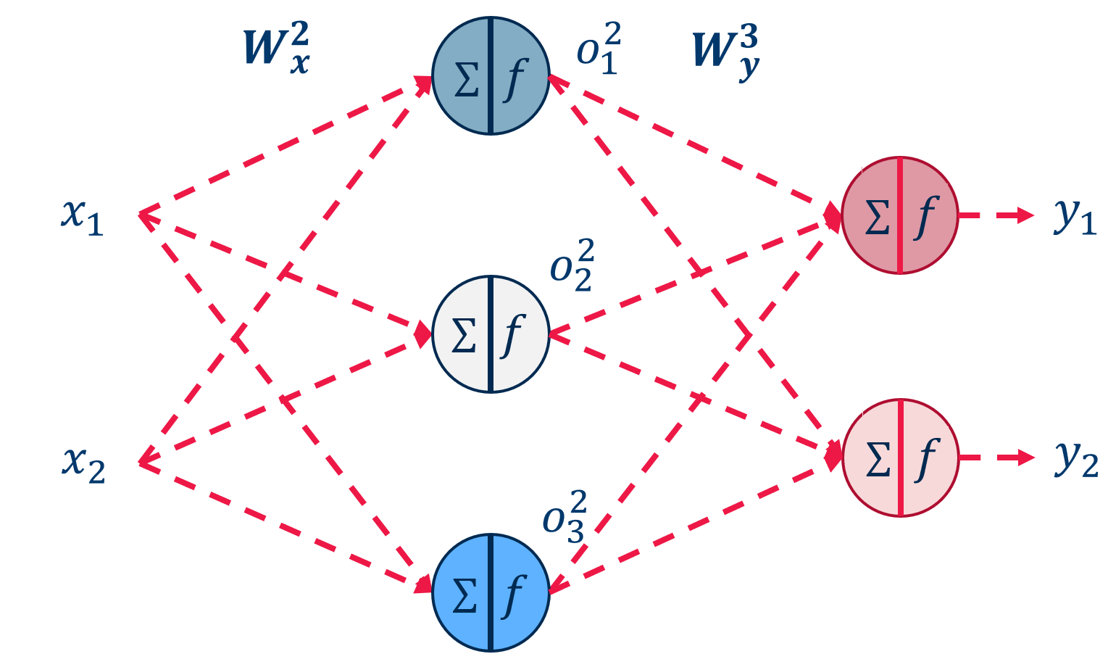




Update formula for weights to the output layer after all samples in T
Final formula to update the weight $w_{ji}^{out}$, after all training samples in T have passed:
$$∆w_{ji}^{out}=−η\sum_{x∈T}{δ_{j}^{out}{ o}_{i}^{hidden}}$$
$$δ_{j}^{out}= \left(y_{j}−t_{j}\right) f^{′}\left({net}_{j}\right)$$
$w_{ji}$
$$δ_{j}^{out}$$
$$w_{ji}^{out}$$
$$o_{i}^{hidden}$$
Guide to Intelligent Data Science Second Edition, 2020

Slide 53






In the hidden layers...
Now, where do we get the target values for the hidden neurons?
Let’s continue with gradient descent:
$$∆w_{ij}^{hidden}=−η\frac{∂E}{∂w_{ij}^{hidden}}$$
$$x_{i}$$
$$δ_{k}^{out}$$
$$w_{ji}^{hidden}$$
$$w_{jk}^{out}$$
$$o_{j}^{hidden}$$
Guide to Intelligent Data Science Second Edition, 2020

Slide 54
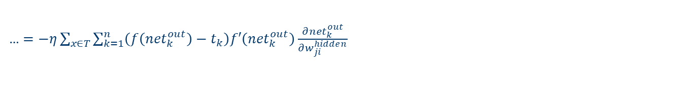
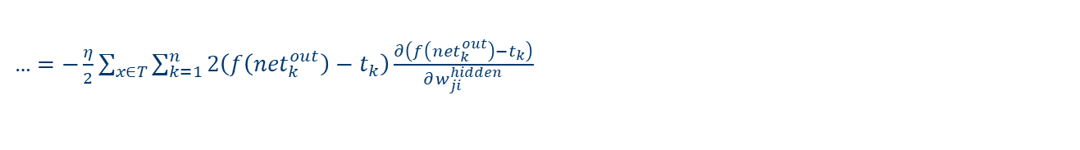
… some Calculations for the Hidden Layer …
$$∆w_{ji}^{hidden}=− η\frac{∂\frac{1}{2}\sum_{x∈T}{\sum_{k=1}^{n}{{\left(y_{k}−t_{k}\right)}^{2}}}}{∂w_{ij}^{hidden}}=−\frac{η}{2}\sum_{x∈T}{\sum_{k=1}^{n}{\frac{∂{\left(f\left({net}_{k}^{out}\right)−t_{k}\right)}^{2}}{∂w_{ji}^{hidden}}}}$$
… $=−\frac{η}{2}\sum_{x∈T}{\sum_{k=1}^{n}{2\left(f\left({net}_{k}^{out}\right)−t_{k}\right)\frac{∂\left(f\left({net}_{k}^{out}\right)−t_{k}\right)}{∂w_{ji}^{hidden}}}}$
… $=−η\sum_{x∈T}{\sum_{k=1}^{n}{\left(f\left({net}_{k}^{out}\right)−t_{k}\right)f′\left({net}_{k}^{out}\right)\frac{∂{net}_{k}^{out}}{∂w_{ji}^{hidden}}}}$
… $=−η\sum_{x∈T}{\sum_{k=1}^{n}{\left(f\left({net}_{k}^{out}\right)−t_{k}\right)f′\left({net}_{k}^{out}\right)\frac{∂\sum_{j^{′}=1}^{h}{w_{j^{′}k}^{out}}{ o}_{j′}^{hidden}}{∂w_{ji}^{hidden}}}}$
If just one hidden layer
… $=−η\sum_{x∈T}{\sum_{k=1}^{n}{\left(f\left({net}_{k}^{out}\right)−t_{k}\right)f′\left({net}_{k}^{out}\right)\frac{∂\sum_{j^{′}=1}^{h}{w_{j^{′}k}^{out}}f\left(\sum_{i^{′}=1}^{m}{w_{i^{′}j^{′}}^{hidden}∙x_{i^{′}}}\right)}{∂w_{ji}^{hidden}}}}$
… $=−η\sum_{x∈T}{\sum_{k=1}^{n}{{ δ}_{k}^{out} \frac{∂\sum_{j^{′}=1}^{h}{w_{j^{′}k}^{out}}f\left(\sum_{i^{′}=1}^{m}{w_{i^{′}j^{′}}^{hidden}∙x_{i^{′}}}\right)}{∂w_{ji}^{hidden}}}}$
… $=−η\sum_{x∈T}{\sum_{k=1}^{n}{{ δ}_{k}^{out}{ w}_{jk}^{out} \frac{∂f\left(\sum_{i^{′}=1}^{m}{w_{i^{′}j}^{hidden}∙x_{i^{′}}}\right)}{∂w_{ji}^{hidden}}}}$
Guide to Intelligent Data Science Second Edition, 2020

Slide 55


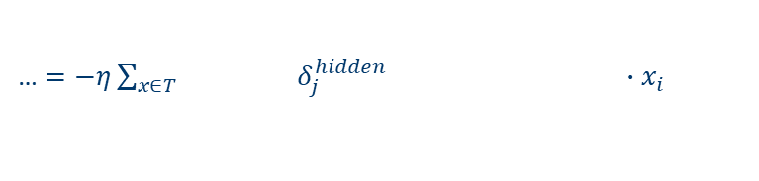



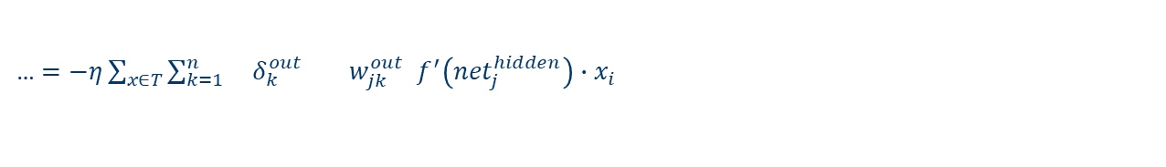



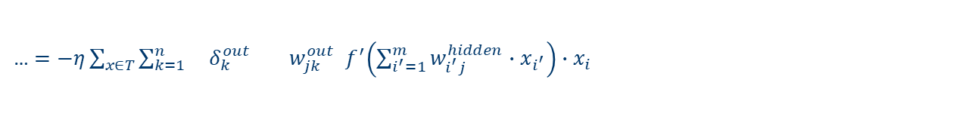



… some Calculations for the Hidden Layer …
… $=−η\sum_{x∈T}{\sum_{k=1}^{n}{{ δ}_{k}^{out}{ w}_{jk}^{out} \frac{∂f\left(\sum_{i^{′}=1}^{m}{w_{i^{′}j}^{hidden}∙x_{i^{′}}}\right)}{∂w_{ji}^{hidden}}}}$
… $=−η\sum_{x∈T}{\sum_{k=1}^{n}{{ δ}_{k}^{out}{ w}_{jk}^{out}{ f}^{′}\left(\sum_{i^{′}=1}^{m}{w_{i^{′}j}^{hidden}∙x_{i^{′}}}\right)∙x_{i}}}$
$$x_{i}$$
$$δ_{k}^{out}$$
$$w_{jk}^{out}$$
… $=−η\sum_{x∈T}{\sum_{k=1}^{n}{{ δ}_{k}^{out}{ w}_{jk}^{out}{ f}^{′}\left({net}_{j}^{hidden}\right)∙x_{i}}}$
$$w_{ji}^{hidden}$$
$$o_{j}^{hidden}$$
… $=−η\sum_{x∈T}{{ δ}_{j}^{hidden} ∙x_{i}}$
As for weights to output neurons
$$∆w_{ji}^{hidden}=− η\sum_{x∈T}{{ δ}_{j}^{hidden}x_{i}}$$
${ δ}_{k}^{out}$ is back-propagated from output to input
$$δ_{j}^{hidden}=\sum_{k=1}^{n}{{ δ}_{k}^{out}{ w}_{jk}^{out}{ f}^{′}\left({net}_{j}^{hidden}\right)}$$
$$x_{i}$$
$$δ_{k}^{out}$$
$$w_{ji}^{hidden}$$
$$w_{jk}^{out}$$
$$o_{j}^{hidden}$$
Guide to Intelligent Data Science Second Edition, 2020

Slide 56
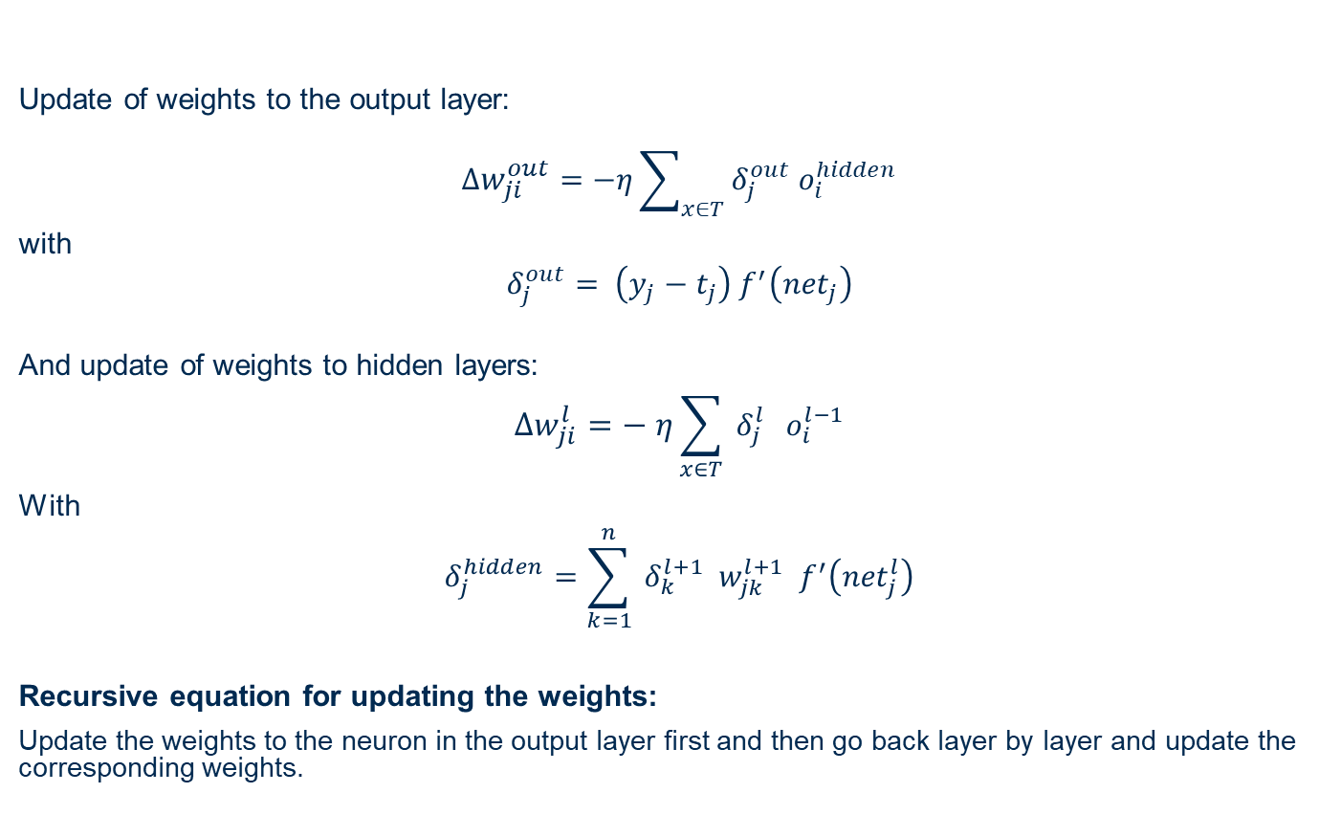
Error BackPropagation or Generalized Delta Rule
Update of weights to the output layer:
$$∆w_{ji}^{out}=−η\sum_{x∈T}{δ_{j}^{out}{ o}_{i}^{hidden}}$$
with
$$δ_{j}^{out}= \left(y_{j}−t_{j}\right) f^{′}\left({net}_{j}\right)$$
And update of weights to hidden layers:
$$∆w_{ji}^{l}=− η\sum_{x∈T}{{ δ}_{j}^{l}{ o}_{i}^{l−1}}$$
With
$$δ_{j}^{hidden}=\sum_{k=1}^{n}{{ δ}_{k}^{l+1}{ w}_{jk}^{l+1}{ f}^{′}\left({net}_{j}^{l}\right)}$$
Recursive equation for updating the weights:
Update the weights to the neuron in the output layer first and then go back layer by layer and update the corresponding weights.
Previous layer
Current
hidden
layer
Next layer
Guide to Intelligent Data Science Second Edition, 2020

Slide 57




Update formula for weights after each sample in T
Final formula to update the weight $w_{ji}^{out}$, after one single training sample in T :
$$E=\frac{1}{2}\sum_{k=1}^{n}{{\left(y_{k}−t_{k}\right)}^{2}}$$
$$∆w_{ji}^{l}=− η{ δ}_{j}^{l}{ o}_{i}^{l−1}$$
${ δ}_{j}^{l} =$ $\left\{\begin{matrix}\begin{aligned} \left(y_{j}−t_{j}\right){ f}^{′}\left({net}_{j}^{l}\right) l=output layer \\ \end{aligned} \\ \sum_{k=1}^{n}{{ δ}_{k}^{l+1}{ w}_{jk}^{l+1}{ f}^{′}\left({net}_{j}^{l}\right)} l=hidden layer\end{matrix}\right.$
Error function after each training sample
$$δ_{j}^{out}$$
$$w_{ji}^{out}$$
$$o_{i}^{hidden}$$
No sum on training set T
Same as before
Guide to Intelligent Data Science Second Edition, 2020

Slide 58
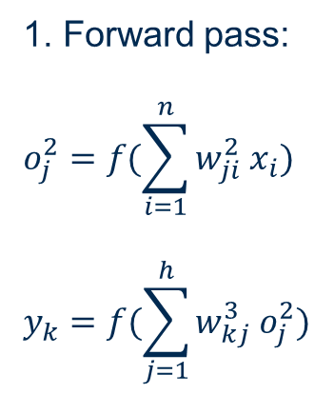
Step 1. Forward Pass
Input
Layer
Hidden
Layer
Output
Layer
$$W_{x}^{2}$$
$$o_{1}^{2}$$
$$W_{y}^{3}$$
$$∑$$
$$f$$
$$x_{1}$$
$$∑$$
$$f$$
$$y_{1}$$
1. Forward pass:
$$o_{j}^{2}=f(\sum_{i=1}^{n}{w_{ji}^{2}{ x}_{i}})$$
$$y_{k}=f(\sum_{j=1}^{h}{w_{kj}^{3}{ o}_{j}^{2}})$$
$$o_{2}^{2}$$
$$∑$$
$$f$$
$$x_{2}$$
$$∑$$
$$f$$
$$y_{2}$$
$$o_{3}^{2}$$
$$∑$$
$$f$$
Guide to Intelligent Data Science Second Edition, 2020

Slide 59


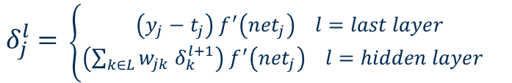





Step 2. Backward Pass - $δ$
Input
Layer
Hidden
Layer
Output
Layer
$$W_{x}^{2}$$
$$o_{1}^{2}$$
$$W_{y}^{3}$$
$$∑$$
$$f$$
$${\text{δ}}_{1}^{hidden}$$
$$x_{1}$$
$$∑$$
$$f$$
$${\text{δ}}_{1}^{out}$$
$$o_{2}^{2}$$
This is${ o}_{j} \left(1−o_{j}\right)$for a sigmoid activation function
δ^{out}
$$∑$$
$$f$$
$${\text{δ}}_{2}^{hidden}$$
$$f$$
$${\text{δ}}_{2}^{out}$$
2. Backward pass:
$$x_{2}$$
$$∑$$
$$o_{3}^{2}$$
${ δ}_{j}^{l} =$ $\left\{\begin{matrix} \left(y_{j}−t_{j}\right){ f}^{′}\left({net}_{j}\right) l=last layer \\ \left(\sum_{k∈L}{w_{jk}{ δ}_{k}^{l+1}}\right){ f}^{′}\left({net}_{j}\right) l=hidden layer\end{matrix}\right.$
$$∑$$
$$f$$
$${\text{δ}}_{3}^{hidden}$$
Guide to Intelligent Data Science Second Edition, 2020

Slide 60













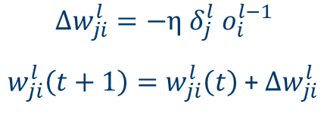











Step 3: Learning after each training pattern
Input
Layer
Hidden
Layer
Output
Layer
$$W_{x}^{2}$$
$$o_{1}^{2}$$
$$W_{y}^{3}$$
$$∑$$
$$f$$
$${\text{δ}}_{1}^{hidden}$$
$$x_{1}$$
$$∑$$
$$f$$
$${\text{δ}}_{1}^{out}$$
3. Weight Update after each training example:
$$o_{2}^{2}$$
δ^{out}
$$∑$$
$$f$$
$${\text{δ}}_{2}^{hidden}$$
$${\text{δ}}_{2}^{out}$$
$$∆w_{ji}^{l}=−η{ δ}_{j}^{l}{ o}_{i}^{l−1}$$
$w_{ji}^{l}\left(t+1\right)=w_{ji}^{l}\left(t\right)$ + $∆w_{ji}^{l}$
$$x_{2}$$
$$∑$$
$$f$$
$$o_{3}^{2}$$
$$∆w_{ij}^{hidden}=−η δ_{j}^{hidden}x_{i}$$
$∆w_{jk}^{out}=−η δ_{k}^{out}$ ${ o}_{j}^{hidden}$
$$∑$$
$$f$$
$$i=1, …, m$$
# inputs
$${\text{δ}}_{3}^{hidden}$$
$$j=1, …, h$$
$$j=1, …, h$$
# hidden units
$$k=1, …, n$$
# outputs
Guide to Intelligent Data Science Second Edition, 2020

Slide 61
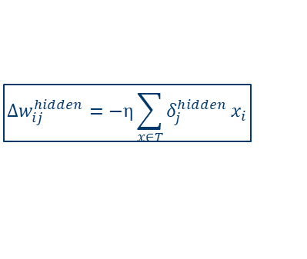
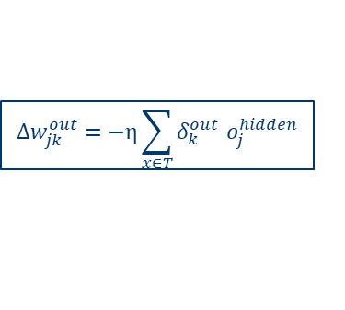

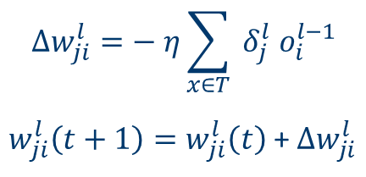


Step 3: Learning after all training patterns
Input
Layer
Hidden
Layer
Output
Layer
$$W_{x}^{2}$$
$$o_{1}^{2}$$
$$W_{y}^{3}$$
$$∑$$
$$f$$
$${\text{δ}}_{1}^{hidden}$$
Learning rate
$$x_{1}$$
$${\text{δ}}_{1}^{out}$$
4. Weight Update after all training examples:
$$∑$$
$$f$$
$$o_{2}^{2}$$
δ^{out}
$$∑$$
$$f$$
$${\text{δ}}_{2}^{hidden}$$
$$∆w_{ji}^{l}=− η\sum_{x∈T}{{ δ}_{j}^{l}{ o}_{i}^{l−1}}$$
$w_{ji}^{l}\left(t+1\right)=w_{ji}^{l}\left(t\right)$ + $∆w_{ji}^{l}$
$$x_{2}$$
$$∑$$
$$f$$
$${\text{δ}}_{2}^{out}$$
$$o_{3}^{2}$$
$$∆w_{ij}^{hidden}=−η\sum_{x∈T}{δ_{j}^{hidden}}x_{i}$$
$$∆w_{jk}^{out}=−η\sum_{x∈T}{δ_{k}^{out}{ o}_{j}^{hidden}}$$
$$∑$$
$$f$$
$$i=1, …, m$$
# inputs
$${\text{δ}}_{3}^{hidden}$$
$$j=1, …, h$$
$$j=1, …, h$$
# hidden units
$$k=1, …, n$$
# outputs
Guide to Intelligent Data Science Second Edition, 2020

Slide 62
Training the bias values
Remember?
Bias values can be considered as special weights to constant inputs +1
Therefore biases are trained together with all other weights
Artificial Neuron (Perceptron)
$$y={f(x}_{1}w_{1}+x_{2}w_{2}+b)$$
$$x_{0}=+1$$
$$x_{1}$$
$$b=w_{0}$$
$$b=w_{0}$$
$$b$$
Neuron bias can be considered as a weight $w_{0}$to a constant input $x_{0}= +1$
$$w_{1}$$
$$a(x)=\sum_{i=0}^{n}{x_{i}w_{i}}$$
f( )
y
$$∑$$
$$σ$$
$$x_{2}$$
$$w_{2}$$
$$y(x)=f(\sum_{i=0}^{n}{x_{i}w_{i}})$$
Guide to Intelligent Data Science Second Edition, 2020

Slide 63
Training: Batch vs. Online
Offline Training: Weight update after all training patterns
  correct
  computationally expensive and slow
  works with reasonably large learning rates (fewer updates!)
Online (Stochastic) Training: Weight update after each training pattern
  approximation (can in theory run into oscillations)
  faster (fewer epochs!)
  smaller learning rates necessary
Batch Training: Weight update after a batch of training patterns
  A compromise between the two
Guide to Intelligent Data Science Second Edition, 2020

Slide 64
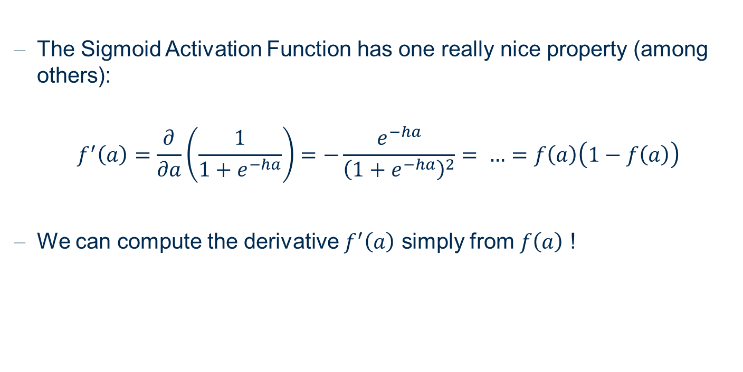
Sigmoid Activation Function
The Sigmoid Activation Function has one really nice property (among others):
$$f^{′}\left(a\right)=\frac{∂}{∂a}\left(\frac{1}{1+e^{−ha}}\right)=−\frac{e^{−ha}}{{\left(1+e^{−ha}\right)}^{2}}= …=f\left(a\right)\left(1−f\left(a\right)\right)$$
We can compute the derivative $f^{′}\left(a\right)$ simply from $f\left(a\right)$ !
Guide to Intelligent Data Science Second Edition, 2020

Slide 65
BackPropagation Example

Slide 66
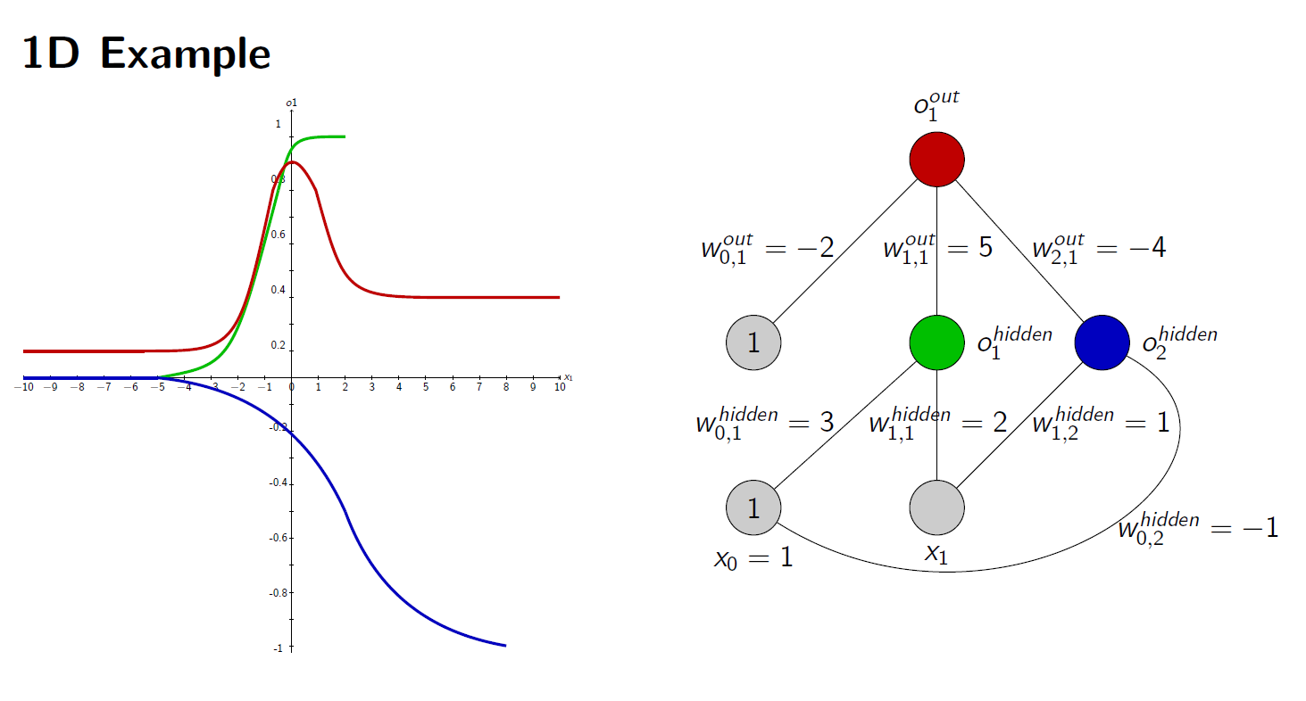
BackPropagation example
Guide to Intelligent Data Science Second Edition, 2020

Slide 67

BackPropagation Example
Guide to Intelligent Data Science Second Edition, 2020

Slide 68

BackPropagation Example
Guide to Intelligent Data Science Second Edition, 2020

Slide 69

BackPropagation Example
Guide to Intelligent Data Science Second Edition, 2020

Slide 70

BackPropagation Example
Guide to Intelligent Data Science Second Edition, 2020

Slide 71

BackPropagation Example
Guide to Intelligent Data Science Second Edition, 2020

Slide 72
Variations of BackPropagation

Slide 73

Local Minima and Learning Rate
Backpropagation as a gradient descent technique can only find a local minimum.
Training the networks with different random initialisations can lead to a different weight configuration on a different local minimum.
The learning rate $η$ defines the step width of the gradient descent technique.
  A very large $η$ leads to skipping minima or oscillations.
  A very small $η$ leads to starving, i.e. slow convergence or even convergence before the (local) minimum is reached.
Guide to Intelligent Data Science Second Edition, 2020

Slide 74






Learning Rate $η$
$η$too small
$η$too large
$η$ just right
Guide to Intelligent Data Science Second Edition, 2020
Notes:
Another point which highly influences how quickly the algorithm converges is the step length delta s, often called learning rate in machine learning.
The picture show what happens if the learning rate is to too small, too large or just right.

Slide 75
FFNNs and Overfitting
Feed-Forward Neural Networks can potentially describe very complex relationships
FFNNs are very simple but very flexible neural architectures
It is easy to:
  Expand the architecture by adding more units/layers
  Experiment with new activation functions
Too many parameters!
Danger of fitting training data too well: Overfitting
  Modeling of particularities in training data instead of underlying concept
    Modeling of artifacts or outliers
Guide to Intelligent Data Science Second Edition, 2020

Slide 76
Back-Propagation: Optimizations
Overfitting can be prevented by keeping the weights small
Weight Decay:
  push all weights to zero
  only those weights that are really needed will “survive”
Momentum Term:
  increase weight updates as long as they have the same sign
Resilient Backpropagation (or RPROP):
  estimate optimum for weights based on assumption that the error surface is a polynomial.
Regularization:
  a regularization term is added to the Error function as to force the weights to stay small or few.
Guide to Intelligent Data Science Second Edition, 2020

Slide 77

Momentum Term
Introduce a momentum term:
For the weight update, the previous weight update is taken into account:
$$∆_{p}W\left(u,v\right)=η{ δ}_{v}^{p}{ o}_{u}^{p}+β{ ∆}_{q}W\left(u,v\right)$$
$∆_{q}W\left(u,v\right)$is the weight update at the previous step $q$ of the gradient descent algorithm.
If weight is updated continuously in the same direction, the weight update increases, otherwise it decreases.
Typical choices: $η=0.2$, $β=0.8$
Guide to Intelligent Data Science Second Edition, 2020

Slide 78
Knowledge Extraction and MLPs
MLPs are powerful but black boxes
Rule extraction only possible in some cases
  VI-Analysis (interval propagation)
  extraction of decision trees
Problems:
  Global influence of each neuron
  Interpretation of hidden layer(s) complicated
Possible Solution:
  Local activity of neurons in hidden layer: Local Basis Function Networks
Guide to Intelligent Data Science Second Edition, 2020

Slide 79
BackPropagation Issues
Usually, weights are not updated after a whole epoch, i.e. after all patterns have been presented once (offline training), or after the presentation of each input pattern (online training, but after a batch of input patterns (batch training).
There is no general rule on how to choose the number of hidden layers and the size of the hidden layers.
  Small neural networks might not be flexible enough to fit the data.
  Large neural networks tend to overfit the data (note: Deep Learning...).
The steepness of the activation function is usually fixed and is not adjusted.
A perceptron learns only in those regions where the activation function is not close to zero or one, otherwise the derivative is almost zero (the problem of the vanishing gradient).

Slide 80


The autoencoder architecture
Dimensionality reduction
Input and output are identical, i.e. the neural network should learn the identity function. (Auto-associative network)
Introduce a hidden layer with only $h<n$ neurons: the bottleneck.
Train the neural network with the data.
After training, input the data into the network and use the outputs of the bottleneck neurons as a representation of the input data in a lower dimension
If $h=2$ then the outputs of the bottleneck neurons represent the two dimensions for the graphical representation of the data

Slide 81
The autoencoder architecture
Anomaly Detection
Input and output are identical, i.e. the neural network should learn the identity function. (Auto-associative network)
Train the neural network with the data.
After training, input the data into the network and calculate the distance between input and output layer.
If input data is similar to training data, then distance is small.
If input data is an anomaly not present in the training data, then distance is large

Slide 82
Other Neural Network Topics
(Hard/Soft) Competitive Learning
Learning Vector Quantization
Self Organizing Maps
Radial (and other) Basis Function Networks
Many connections to Kernel Methods and Support Vector Machines...

Slide 83
Summary
What is a Perceptron?
Why do we need MLPs?
The BackPropagation algorithm to train the hidden layers
Issues with MLPs and BackPropgation
The autoencoder architecture

Slide 84
KNIME Deep Learning Keras Extension

Slide 85

Keras + KNIME
KNIME Deep Learning Extension builds on top of the Keras Libraries
The Keras libraries build on top of TensorFlow
Deep Learning libraries from TensorFlow and Keras are accessible via Python ...
... And KNIME with the Deep Learning Keras Integration.
With KNIME GUI

Slide 86
Installation

Slide 87
Installations
Deep Learning in KNIME Analytics Platform comes with a specific integration. Few simple steps are necessary to get it up and running.
On your machine:
  Anaconda with Python3 correctly installed
Extensions installed on KNIME Analytics Platform
  KNIME Deep Learning - Keras Integration
  KNIME TensorFlow Integration
NOTE: This is a just quick start guide to start using Deep Learning with your KNIME Analytics Platform. If you are experiencing issues or want to customize your installation, please refer to KNIME Deep Learning Integration Installation Guide

Slide 88


Installation of KNIME Extensions
Drag and drop the icon into the KNIME Workbench
A window will pop up asking to install the Extension
After installation you will be asked to restart KNIME

Slide 89

Configuration
Go to the Python Deep Learning Preference page located at
File > Preferences
From the window that pops up, select KNIME > Python Deep Learning from the list on the left.

Slide 90

Configuration
Provide the path to the folder containing your Anaconda installation
Click on New Environment to set up a new ready-to-go environment containing all the required dependencies
NOTE: You can also select an existing Python Deep Learning environment from the drop down menu, if you have already set up one

Slide 91

Configuration
Provide a name for the new environment
Choose if you want to create a new CPU or GPU environment
This creates a new conda environment containing all required Python Deep Learning dependencies
Only choose GPU if you have a TensorFlow compatible GPU available. More information about Python Deep Learning GPU support can be found here

Slide 92
Deep Learning Nodes

Slide 93





Layer Overview (optional)

Slide 94


Keras Input Layer
Allows to define the input shape
Use [x,y] for sequential data
  x = sequence length
  y = dimension of one element in the sequence

Slide 95



Keras Dense Layer
Important settings
  Number of Units
  Selection of the activation function
Regularization support
Can be used as hidden layer and as output layer
Tip: Add Name prefix if used as output layer

Slide 96




Simple Network Example

Slide 97


Keras Network Learner – Input Data Tab
Select input columns for the network and correct conversion
Conversion ”From Collection of Number (integer) to One-Hot Vector” can be used to transform index encoding to one-hot encoding

Slide 98


Keras Network Learner – Target Data
Select target column and correct conversion
Select a standard loss function
or define your custom loss
function

Slide 99

Keras Network Learner – Options Tab
Allows to define the training settings
Important settings
  Epochs
  Training batch size
  Shuffle training data…
  Optimizer

Slide 100



Learning Monitor View of the Keras Network Learner

Slide 101




Keras Network Executor

Slide 102


Different Option to Save a Trained Model
The Keras Network Writer node saves the trained model as .h5 file
  knime://knime.workflow/<filename>
Convert your model to a TensorFlow Network for faster execution during deployment and save it as .zip file using the TensorFlow Writer node

Slide 103


Index-based encoding and One-hot Encoding
Index-based
One-hot Encoding
Education | Index
10th | 0
11th | 1
12th | 2
Assoc-acdm | 3
Assoc-voc | 4
Bachelors | 5
Doctorate | 6
HS-grad | 7
Masters | 8
Prof-school | 9
Some-college | 10
 | 10th | 11th | 12th | Assoc-admin | Assoc-voc | Bach. | Doc. | HS-grad | Masters | Prof-school | Some-college
Masters | 0 | 0 | 0 | 0 | 0 | 0 | 0 | 0 | 1 | 0 | 0
11th | 0 | 1 | 0 | 0 | 0 | 0 | 0 | 0 | 0 | 0 | 0
Some-college | 0 | 0 | 0 | 0 | 0 | 0 | 0 | 0 | 0 | 0 | 1
Bach. | 0 | 0 | 0 | 0 | 0 | 1 | 0 | 0 | 0 | 0 | 0
10th | 1 | 0 | 0 | 0 | 0 | 0 | 0 | 0 | 0 | 0 | 0
Doc. | 0 | 0 | 0 | 0 | 0 | 0 | 1 | 0 | 0 | 0 | 0
Prof-school | 0 | 0 | 0 | 0 | 0 | 0 | 0 | 0 | 0 | 1 | 0
HS-grad | 0 | 0 | 0 | 0 | 0 | 0 | 0 | 1 | 0 | 0 | 0
---

Slide 104


Normalization
Input to NN must be in [0,1]
Normalization is needed

Slide 105
Practical Examples with KNIME Analytics Platform

Slide 106
KNIME Workflows
A multilayer perceptron with layers (4–8–3) is trained to classify the iris data set using the backpropagation algorithm, as set in the Keras Network Learner node

Slide 107
Thank you

